Slide 1

Steve's Car Showroom
Kiran Suryawanshi

Slide 2
Introduction
Steve runs a top-end car showroom but his data analyst has just quit and left him without his crucial insights. As a data analyst we have to give insights by solving the questions asked by him.

Slide 3
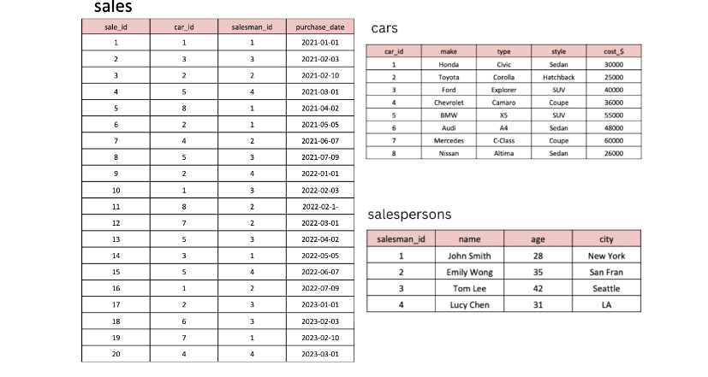
Tables
Here are the tables that I have used:

Slide 4
Questions
What are the details of all cars purchased in the year 2022?
What is the total number of cars sold by each salesperson?
What is the total revenue generated by each salesperson?
What are the details of the cars sold by each salesperson?
What is the total revenue generated by each car type?
What are the details of the cars sold in the year 2021 by salesperson 'Emily Wong’?
What is the total revenue generated by the sales of hatchback cars?
What is the total revenue generated by the sales of SUV cars in the year 2022?
What is the name and city of the salesperson who sold the most number of cars in the year 2023?
What is the name and age of the salesperson who generated the highest revenue in the year 2022?

Slide 5
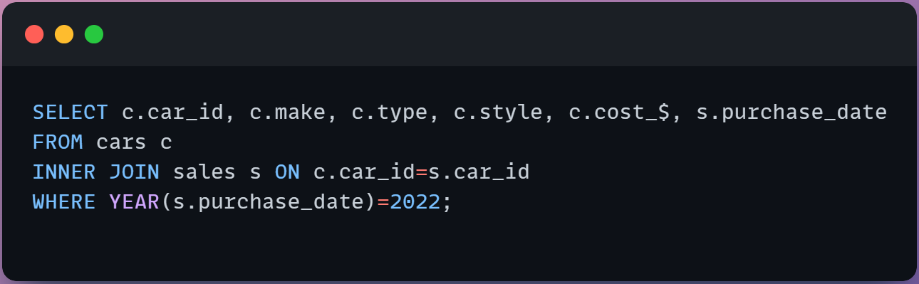
1. What are the details of all cars purchased in the year 2022?

Slide 6
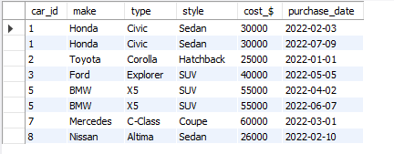
Output =>
Insight: From the result we can see that Honda Sedan, Toyota Hatchback, Ford SUV, BMW SUV, Mercedes Coupe, Nissan Sedan are the cars purchased in 2022.

Slide 7
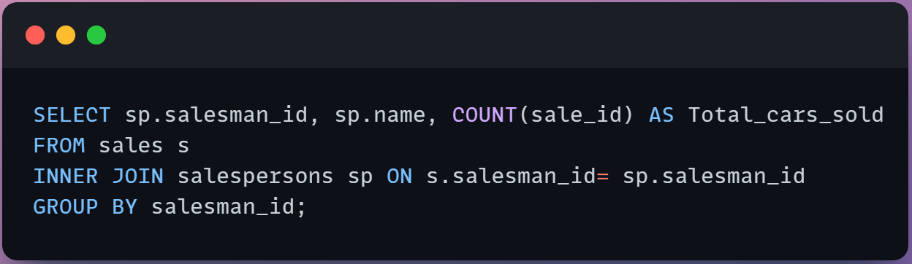
2. What is the total number of cars sold by each salesperson?

Slide 8
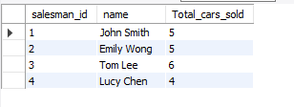
Output =>
Insight: Tom Lee has sold highest number of cars

Slide 9
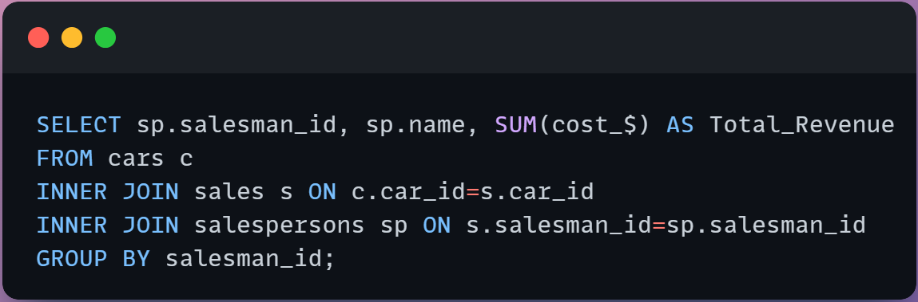
3. What is the total revenue generated by each salesperson?

Slide 10
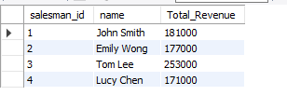
Output =>
Insight: Here we can see that Tom Lee has generated highest revenue among all the other salesman

Slide 11
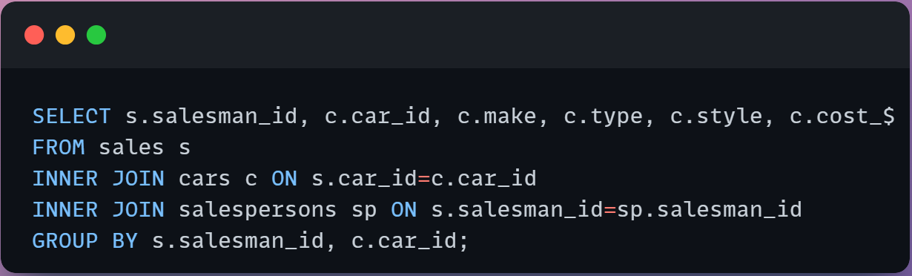
4. What are the details of the cars sold by each salesperson?

Slide 12
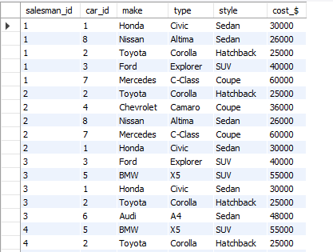
Output =>
Insight: we can see all the car details from above result.

Slide 13
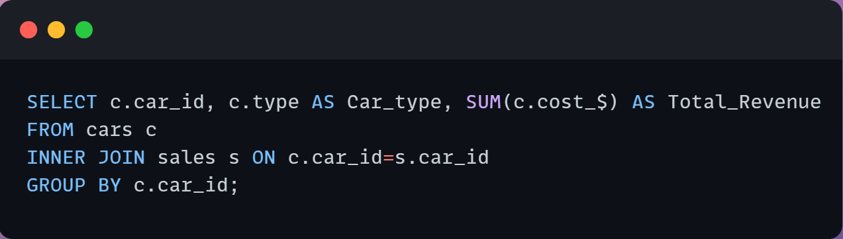
5. What is the total revenue generated by each car type?

Slide 14
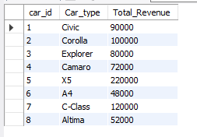
Output =>
Insight: From the result we can observe that car BMW x5 has generated highest revenue i.e. 220000

Slide 15
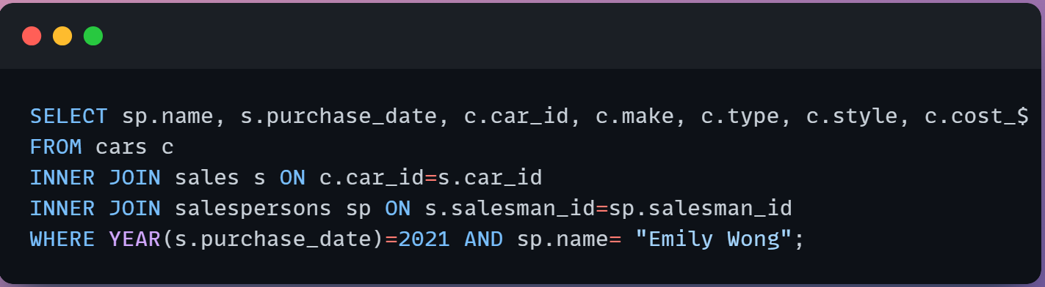
6. What are the details of the cars sold in the year 2021 by salesperson 'Emily Wong’?

Slide 16

Output =>
Insight: we can see that Emily Wong has sold car Toyota corolla and Chevrolet Camaro in the year 2021.

Slide 17
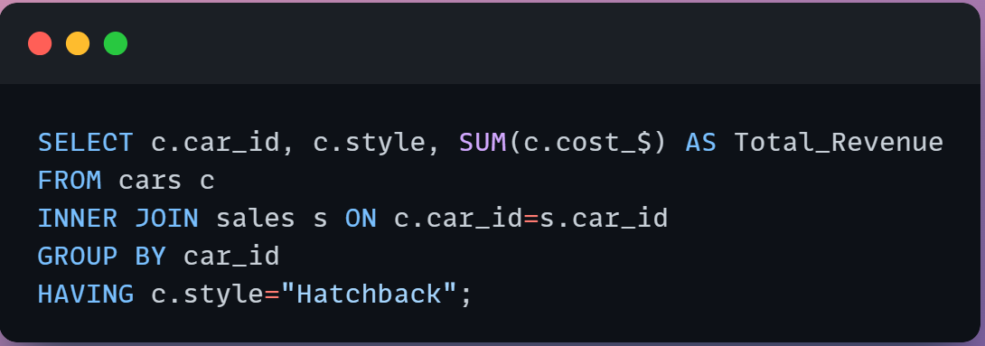
7. What is the total revenue generated by the sales of hatchback cars?

Slide 18

Output =>
Insight: Total revenue generated by Hatchback style car is 100000.

Slide 19
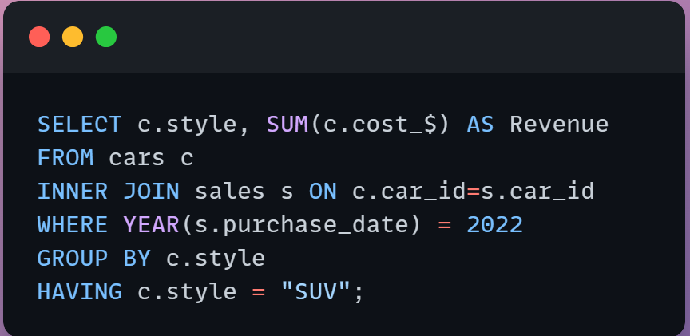
8. What is the total revenue generated by the sales of SUV cars in the year 2022?

Slide 20

Output =>
Insight: Total revenue generated by SUV car in the year 2022 is 150000.

Slide 21
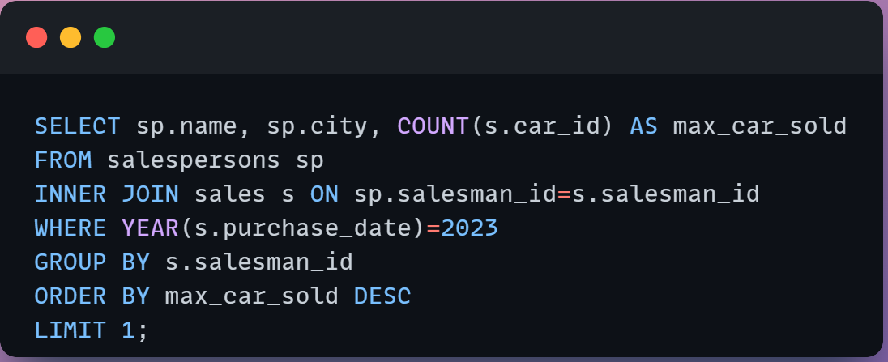
9. What is the name and city of the salesperson who sold the most number of cars in the year 2023?

Slide 22

Output =>
Insight: Tom Lee who is from Seattle has sold maximum cars in the year 2023

Slide 23
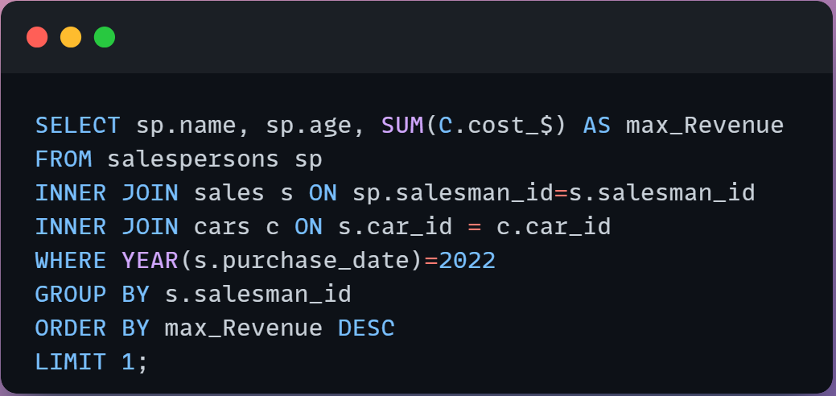
10. What is the name and age of the salesperson who generated the highest revenue in the year 2022?

Slide 24

Output =>
Insight: Emily Wong has generated the highest revenue i.e. 116000 in the year 2022

Slide 25
Thank you

